Slide 1
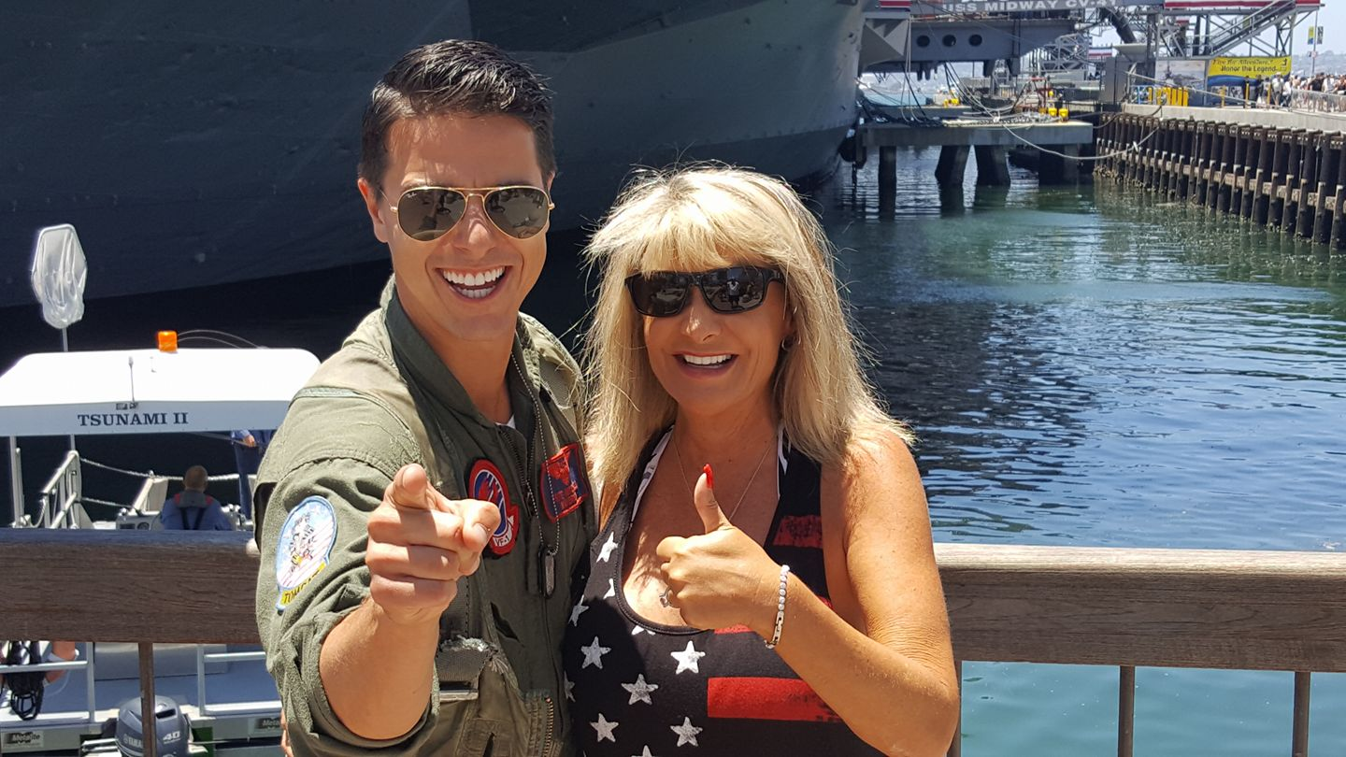
Rockstar Backstage Pass Revenue Share Success
Jeff & Marsee Wilhems –Tucson, AZ
4,600+ Agents 46 FLQA’s
Joined eXp Dec 2016

Slide 2
Mike Grbic 900+ Agents
“Really… I suck at recruiting”
Get people to events
I care A LOT about coaching them to grow their business
Add value and leading the partnership.

Slide 3
Clayton Gits 1300+ Agents
Focus on production more than anything else.
Attract/Recruit Teams and Influencers instead of individual agents
Don’t lead with revenue share and more about how we can provide value

Slide 4
Cliff Freeman 10,000+ Agents
Relationships
Mindset (Come from Contribution)
Faith

Slide 5
Tom Martin 140+ Agents
First thing is be in relationships with agents then meet with them for a business conversation over coffee. Only mastermind on growing each other’s business.
Then ask… “What is your goal?”
Why is that goal important? What is that goal important? Tell me more… until they get real emotional.
Ask them who is helping them achieve their goal?
What happens is you don’t achieve your goal?
Then invite to a class and ask them… If there was a proven way of achieving that goal with systems, tools and a business model…and FREE coaching to get you there would you want to watch a short video to see how?
Show them the video , 3 way with business partners.

Slide 6
Pat Hays 4,600+ Agents
Weekly Lunch & Learns
Promoting and attend all corporate events and attend as many events as you can where you know other agents will be. Build Relationships at those events.
Building UP your leaders and build THROUGH your leaders.

Slide 7
Andrew Franklin 900+ Agents
We have built relationships in the industry for a long time
We have always lead with production first
We have always focused on how we can help our recruits get what THEY want

Slide 8
Tim & Julie Harris 2,200+ Agents
Easier to move fast than slow. Learn the job, stop wasting time and potential getting ready to get started. Fail forward quickly.
People have normalized leading lives of complacency and good enough. Stop being so patient and nice to yourself. Set unreasonable goals and be disappointed in yourself if you fall short.
You only LIVE once but yo are DEAD for a long time. What are you waiting for?
Your mission as a business owner is to create total financial freedom. Most people would be financially free once they have $10K-$15K per month in passive income. That is only a group size of approx. 400.
Only focus on those swimming towards your life boat. Focus on those people!

Slide 9
Shelley Johnson & Craig LePage 3,400+ Agents
Get plugged into and being 100% committed to the outcome of succeeding. Going to every event and getting agents in our group to the events. Show up as a leader and get excited too!
Consistently following up with our prospects. Making sure to connect on a deeper level beyond real estate. Keep going on, even if you are “ghosted”. Remember it’s on their time not ours.
Hosting events of value for the real estate community and helping them with their business.

Slide 10
Andre LaFountaine 700+ Agents
Being very consistent on calling two new people per day M-F and having a conversation where they agreed to book a zoom with me or watch the video I sent. If I didn’t have my 10 appointments for the week I would work half day Saturday until I got my 10.
I had a 5 year goal to be very consistent on the plan above to 500 agents. It took only 2.5 years.
Follow the agent attraction process taught by Jay and Al and not get caught up on what people said, did or did not do. Stay focused on “It’s a numbers game” and stay consistent for 5 years!
It starts slow but NEVER give up. Quitting is NOT an option!

Slide 11
Jay Kinder 8,000+ Agents
Content-interviewing agents that joined eXp and letting them tell their story. Facebook “live” to YOUTUBE.
Creating-following and teaching a duplicatable process that centered around inviting to watch a video, coming to a live presentation or live event followed by a 3 way call with your business partners.
Solving problems-no matter what challenge an agent has I know that with the tools exp has and with the solutions we have developed over the years of being in the business, we can solve their problems too. Understanding their problems so they can accomplish their goals has been the key to our attraction and success!

Slide 12
Adam Bailey 2,200+ Agents
1.Following Building an Empire Process
2. Who I partnered with.
3. Attending and Inviting agents to Top Masterminds every 90 days. Events are magic!

Slide 13
Randy Byrd 800+ Agents
My sponsor Brent Gove. Brent is not only my senior partner, he is amazing at networking and always introduces me to other leaders, players, influencers and corporate staff.
Events-they build belief and do the heavy lifting. I plug into any and all events I can attend.
Collaboration-this is HUGE! All ships rise together. Having Jeff, Jay, Shelley, George and others. None of which are in my organization helping me and cheering me on! It’s the ONE THING…

Slide 14
Dan Beer 6,000+ Agents
1.Not talking publicly about revenue share/stock
2. Leveraging events
3. Growing my sales business

Slide 15
Chris Bear 1,400+ Agents
Consistency with events, we did a lunch and learn for the first year every week and we grew to 101 agents while still selling 100 homes
Supporting the group on every call. The first year I was on every call with my agents.
3. Building out a strong value proposition that will support attraction throughout our seven levels. Coaching, onboarding support, masterminds, events etc.

Slide 16
Bill Price 2,400+ Agents
1.Sell houses, build a relationship with the cross agent and share eXp benefits
2. Create value by having agents join a panel of top agents sharing their success stories.
3. Take agents to lunch or dinner and discuss real estate. I don’t bring up eXp unless they ask about it. I build a trusting relationship and then the next time we get together I will discuss what their retirement strategy/plan looks like. Most never have a retirement plan…Then I bring up eXp.

Slide 17
Shon Kokoszka 1,600+ Agents
1.Scripts, dialogues, and knowing objection handlers. Knowing what to say, how to say it to enough people.
2. Retention- creating valuable weekly mastermind events on zoom focused on creating community.
3. Reproduction-providing valuable training on how to attract agents.

Slide 18
Blake Cory 450+ Agents
Surround yourself with the people you aspire to become (for me it was Jeff Wilhems and Mike Grbic)
Follow Brent’s plan of attack on attracting.
Take Massive Action

Slide 19
Scott Lewis 6,800+ Agents
Doing weekly lunch and learns.
Getting Leaders to big events
Showed the eXp opportunity 40-50 times per week for the first year with eXp

Slide 20
Sheila Fejeran 13,000+ Agents
Weekly Lunch and Learns
Created pre-recorded webinar series for ease of showing the opportunity and leveraging technology
Created my Top 100 list of agents to talk with and to show the opportunity to, starting with all Mega Agents and Teams in my coaching group-Brent Gove

Slide 21
Amanda & Rodney Heard 130+ Agents
Local Events - lunch and learns, eXp eXplained, Wine Socials, Panels, etc.
Building Relationships through production - connecting with the agents and nurturing the relationships.
3. Social Media presence and leveraging the events and our agent interviews on SM. It highlights agents in our organization...creating more interest by sharing their journey in real estate and to eXp and how it has impacted their lives. Like attracts like and we realize by highlighting our agent's they will attract agents we can't reach or connect to.

Slide 22
Gene Frederick aka “The Legend” 16,000 + Agents
Do (3) one on one meetings per day with recruits. You can do by zoom now. Need to do a complete needs analysis with the recruit.
Weekly lunch and learns
Invite to all national and regional agents. eXpCON, eXp Shareholders, Cabo, Dallas (Tony Robbins)

Slide 23
Rob & Jen Flick 19,000+ Agents
Have a very clear, powerful and emotional WHY. Something that can almost make you cry.
Work through other people’s sphere of influence to find a leader. Everybody knows somebody that is a leader.
Let leaders lead! When you find a leader, get tho know their WHY and show them a way to get it. Then get out of their way and let them lead.

Slide 24
Jay & Ashley Nelson 2,200+ Agents
Creating camaraderie and culture by throwing parties at our private and eXp corporate events for our rev share group. Make your group FUN! Agents want to be partnered with FUN people!
We do over 8 live group zooms/wk. Creates a duplicated way that agents can use face to face interaction to train in selling more homes and attracting productive agents. We let multiple agents share their story on each zoom. All cameras must be turned on and we make others participate. Let others share, don’t make it all about you.
Truly making a effort to form real friendships with our agent partners and not just business partnerships.

Slide 25
Jay & Ashley Nelson 2,200+ Agents
4. Don’t take yourself so seriously, let it rip, rock and roll, that helps other agents not feel so much pressure! Pressure sucks, but fun with a structure can help inspire confidence.
5. Then every day say a big Ole “YEEEEEEE HAWWWWW” cause everyone in your group is winning and growing more success and helping each other do the same. God is great Give him the Glory.
Now everybody screem: YEEEEEEEEE HAWWWWWW!

